Slide 1
The Network Layer
Internetworking &
The Network Layer in the Internet
Chapter 5

Slide 2
Internetworking
How networks differ
How networks can be connected
Tunneling
Internetwork routing
Packet fragmentation

Slide 3
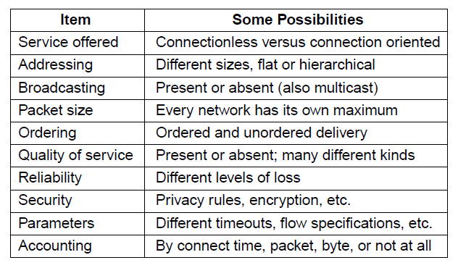
How Networks Differ
Some of the many ways networks can differ

Slide 4
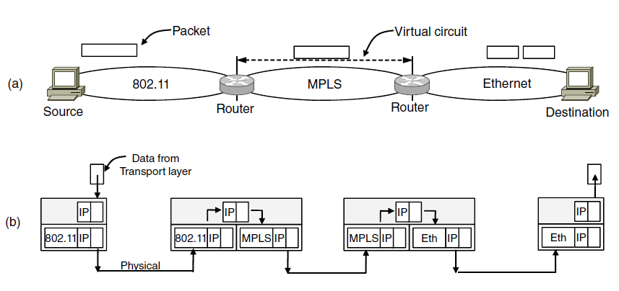
How Networks Can Be Connected
A packet crossing different networks.
Network and link layer protocol processing.
From 802.11 to MPLS – multi-protocol router strips the 802.11 frame and put the MPLS frame and then fragments when it is sent over IP

Slide 5
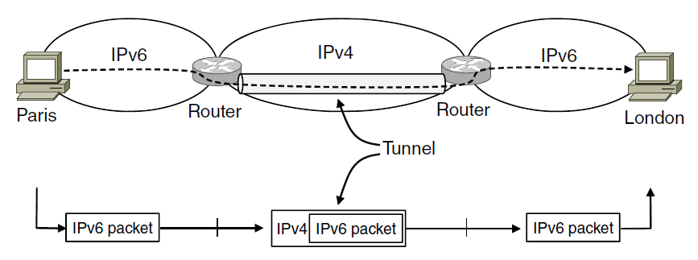
Tunneling (1)
Tunneling a packet from Paris to London.

Slide 6
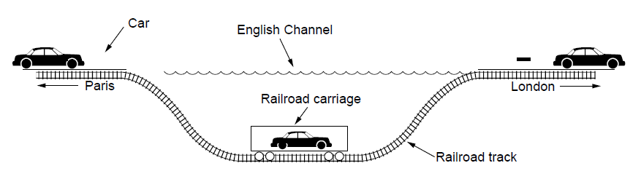
Tunneling (2)
Tunneling a car from France to England
The disadvantage of tunneling is that none of the hosts on the network that is tunneled over can be reached because the packets cannot escape in the middle of the tunnel

Slide 7
Internetwork Routing (1)
Challenges in internetwork routing:
The networks may internally use different routing algorithms (e.g., link state routing and distance vector routing) – finding shortest path becomes tricky.
Networks run by different operators:
  Different ideas about what is a good path through the network – one operator wants least delay, another least cost.
  One operator may not want another operator to know details of the paths in its network.
Individual networks may not need hierarchical solutions, while the combined network (internet) is huge and requires such solutions for scaling

Slide 8
Internetwork Routing (2)
Two-level routing algorithm:
Interior Gateway Protocol (IGP): Intra-domain routing protocol, used within individual networks.
Border Gateway Protocol (BGP): Inter-domain routing protocol, used across the networks which make up the network.
Since each network is operated independently of all the others, it is often referred to as an AS (Autonomous System).
Routes across networks determined by:
Business arrangements between ISPs.
Government laws for countries if internetwork routing requires crossing international boundaries.

Slide 9
Packet Fragmentation (1)
Packet size issues:
Hardware
Operating system
Protocols
Compliance with (inter)national standard.
Reduce error-induced retransmissions
Prevent packet occupying channel too long.

Slide 10
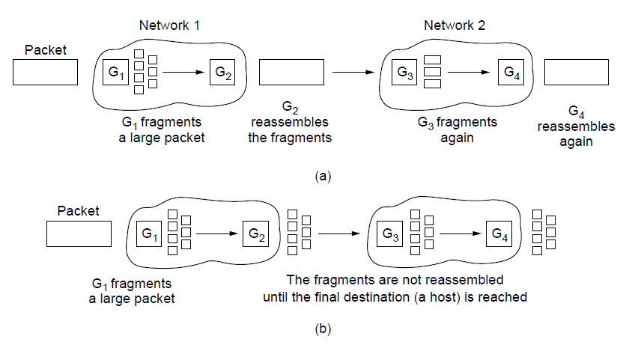
Packet Fragmentation (2)
Transparent fragmentation.
Nontransparent fragmentation

Slide 11
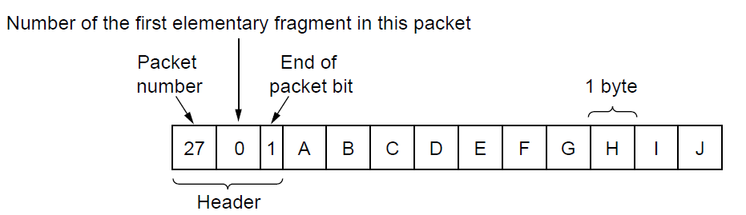
Packet Fragmentation (3)
Fig.: Fragmentation when the elementary data size is 1 byte.
(a) Original packet, containing 10 data bytes.

Slide 12
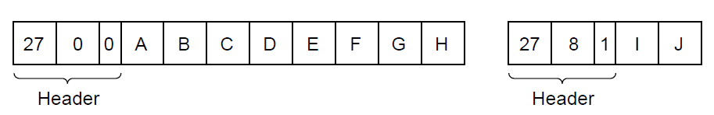
Packet Fragmentation (4)
Fig. (contd.): Fragmentation when the elementary data size is 1 byte
(b) Fragments after passing through a network
with maximum packet size of 8 payload bytes plus header.

Slide 13
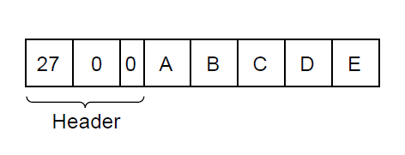
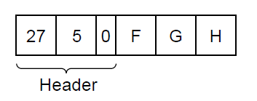
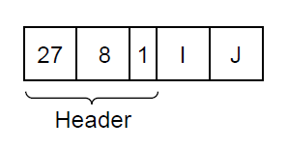
Packet Fragmentation (5)
Fig. (contd.): Fragmentation when the elementary data size is 1 byte
(c) Fragments after passing through a size 5 gateway.

Slide 14
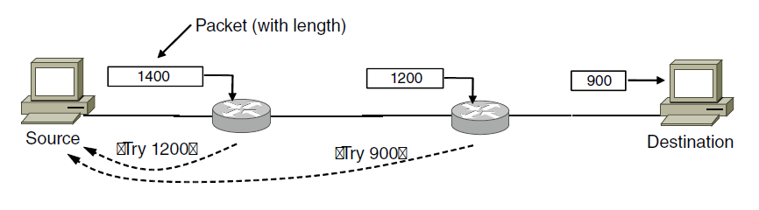
Packet Fragmentation (6)
Path MTU Discovery
MTU: Maximum Transmission Unit – pushes the fragmentation to host from network

Slide 15
The Network Layer in the Internet
The IP Protocol
IP Addresses
Internet Control Protocols
OSPF – The Interior Gateway Routing Protocol
BGP – The Exterior Gateway Routing Protocol
Internet Multicasting
Mobile IP
IPv6

Slide 16
Design Principles for Internet
Make sure it works. – deploy multiple protocol
Keep it simple.
Make clear choices. – not too many options as mentioned in standards
Exploit modularity.
Expect heterogeneity.
  Simple, general and flexible
Avoid static options and parameters.
Look for a good design; it need not be perfect.
Be strict when sending and tolerant when receiving.
Think about scalability.
Consider performance and cost.

Slide 17
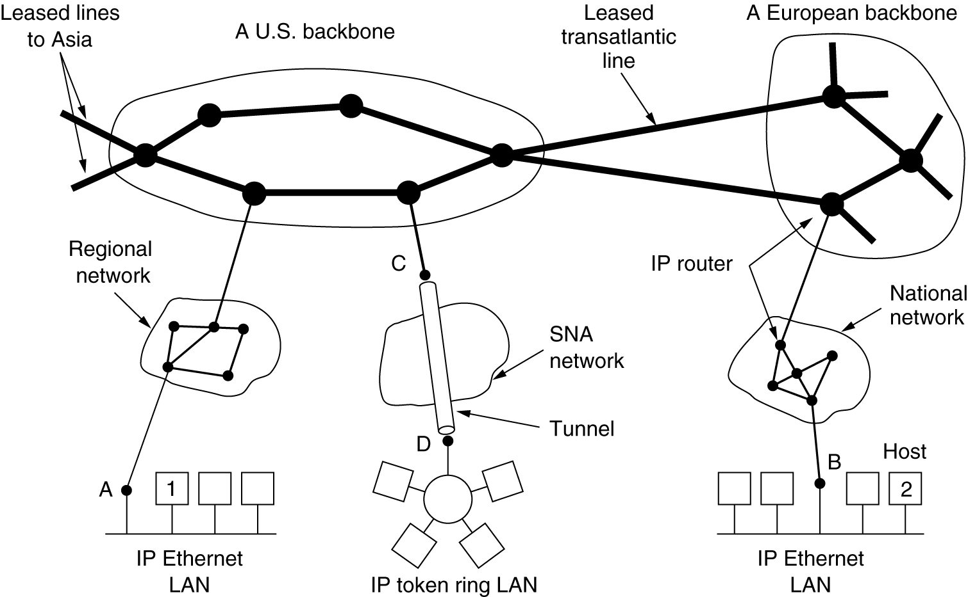
Collection of Subnetworks
The Internet is an interconnected collection of many networks.

Slide 18
Tier – 1 network

Slide 19
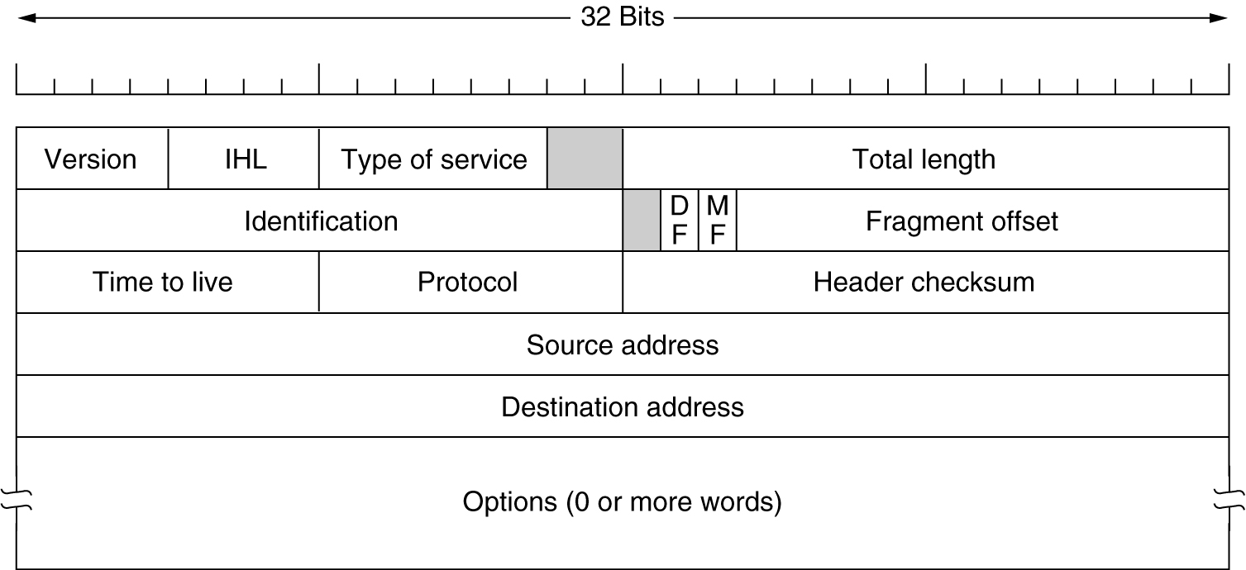
The IP Protocol
The IPv4 (Internet Protocol) header.

Slide 20
The IP Header (1)
Version – IPv4 / IPv6
IHL – how long the header is – in 32 bit word, minimum is 5, maximum is 15 (60 bytes)
Type of Service – (6 bits) – four queuing priority, three discard probabilities and the historical class (Bottom 2 bits –congestion notification)

Slide 21
The IP Header (2)
Total Length – header + data, maximum is 65,535
Identification Field – fragments of a datagram have same Identification value
DF – Don’t Fragment (may mean moving through sub-optimal route, MF- More Fragments (all except the last fragment set).
Fragment offset – all fragments multiple of 8 bytes – 8192 fragments

Slide 22
The IP Header (2)
Time to Live
Protocol – TCP, UDP
Header Checksum – each 16 bit – 1’s complement and total 1’s complement

Slide 23
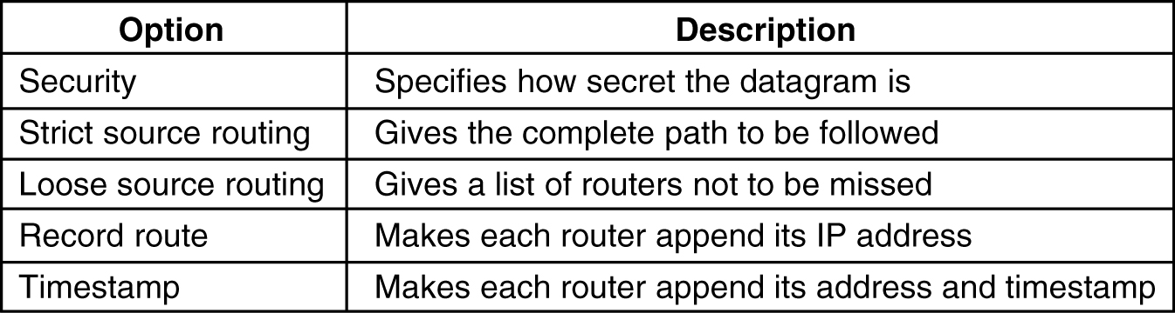
The IP Protocol (2)
5-54
Some of the IP options.

Slide 24
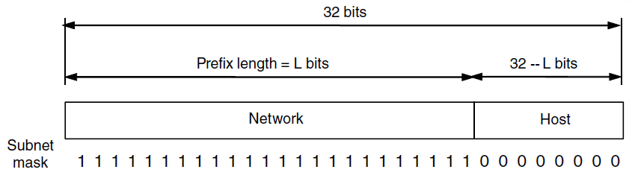
IP Addresses (1)
An IP prefix.

Slide 25
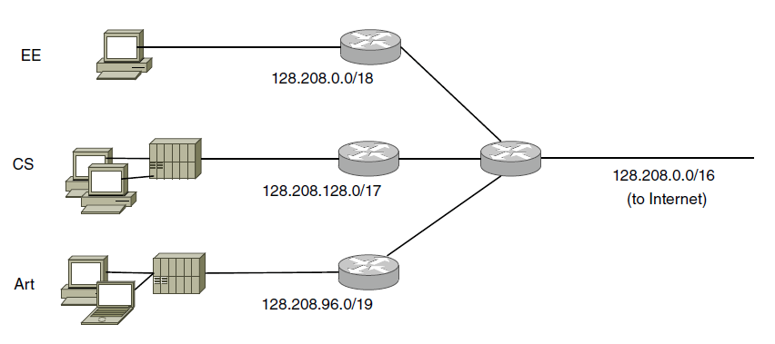
IP Addresses (2)
Splitting an IP prefix into separate networks with subnetting.

Slide 26
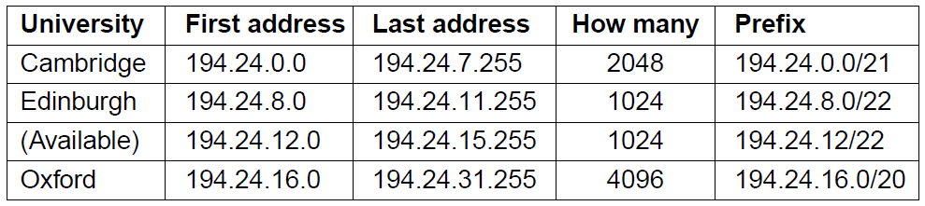
IP Addresses (3)
A set of IP address assignments

Slide 27
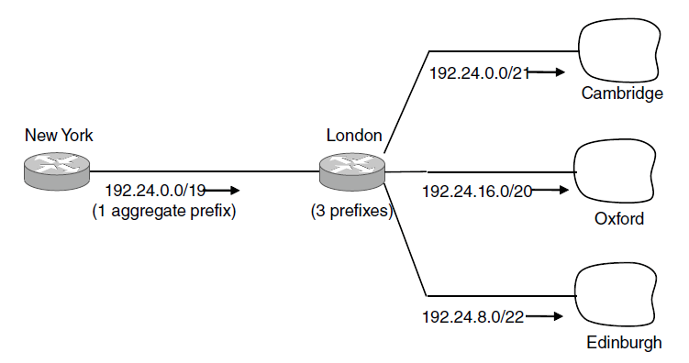
IP Addresses (4)
Aggregation of IP prefixes

Slide 28
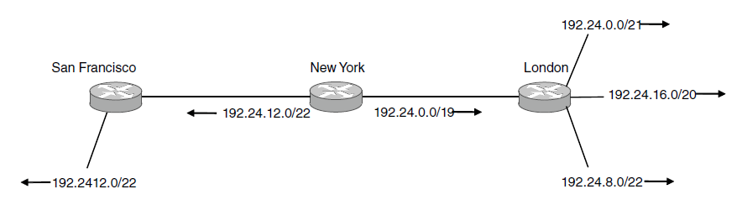
IP Addresses (5)
Longest matching prefix routing at the New York router.

Slide 29
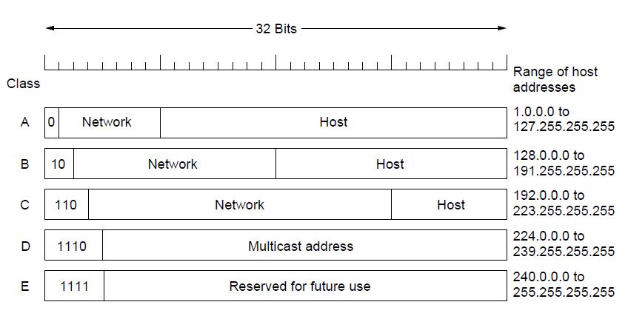
IP Addresses (6)
IP address formats

Slide 30
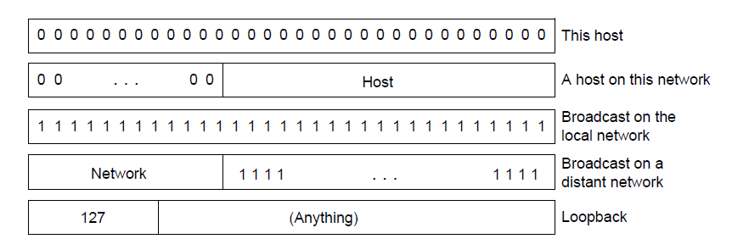
IP Addresses (7)
Special IP addresses

Slide 31
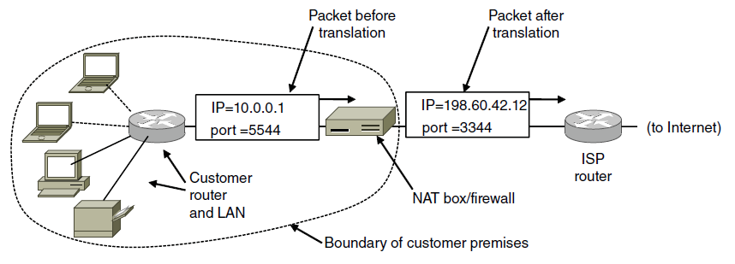
IP Addresses (8)
Placement and operation of a NAT box.

Slide 32
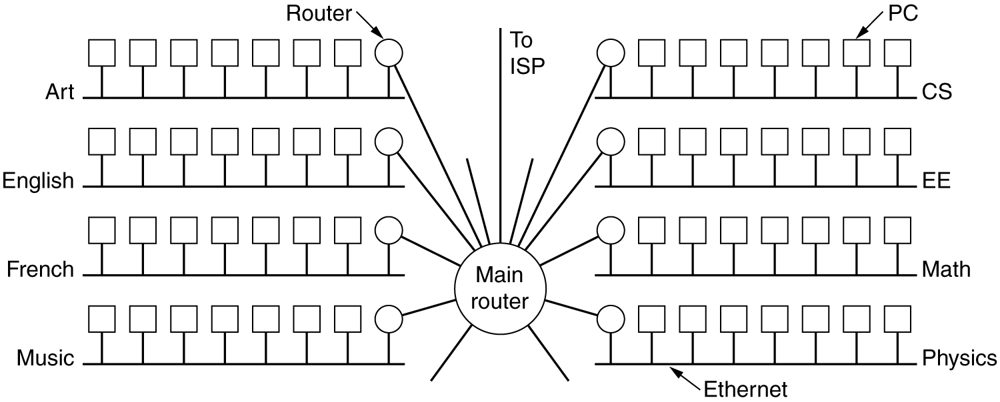
Subnets
A campus network consisting of LANs for various departments.

Slide 33
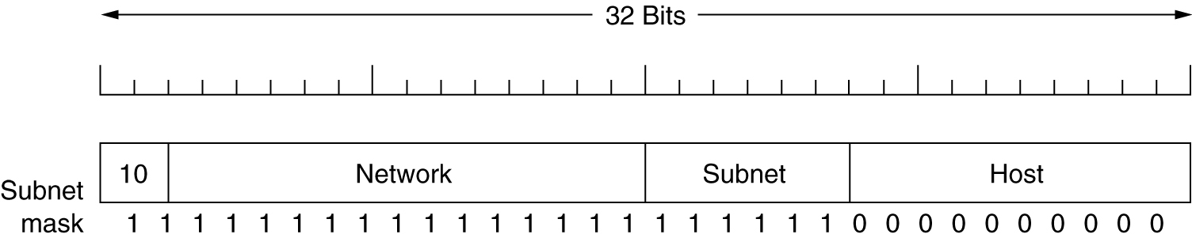
Subnets (2)
A class B network subnetted into 64 subnets.

Slide 34
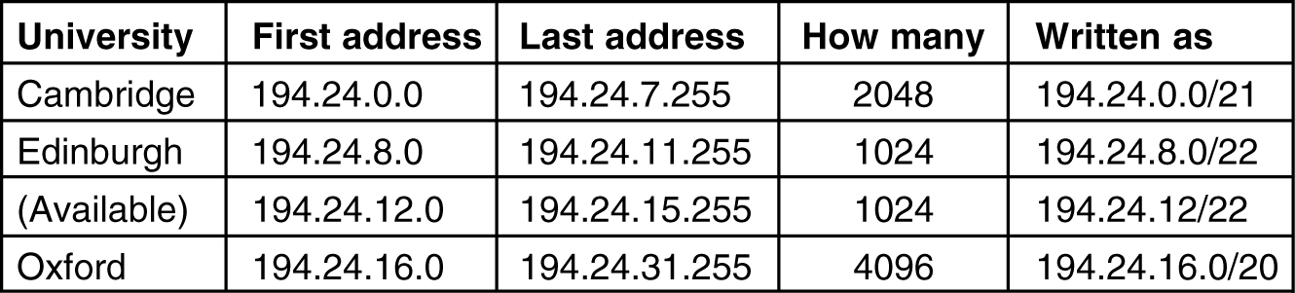
CIDR – Classless Inter-Domain Routing
5-59
A set of IP address assignments.

Slide 35
Address Moving in CIDR
A packet comes in .addressed 194.24.17.4 –compare it with each mask….
Largest Suffix match
Aggregated entry of the three –
194.24.0.0/19
Omaha → Minneapolis, New York, Dallas, Denver
194.24.12.0/22

Slide 36
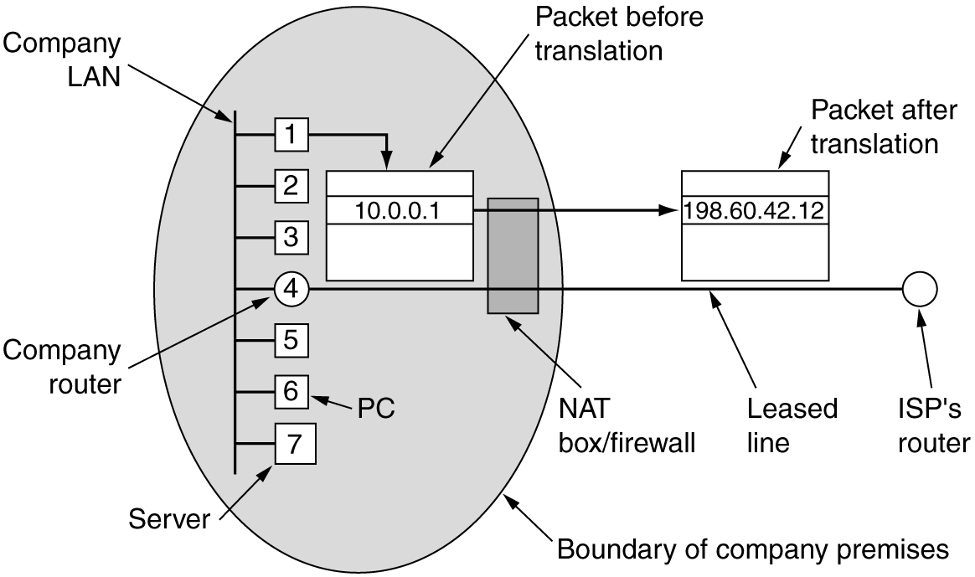
NAT – Network Address Translation
Placement and operation of a NAT box.

Slide 37
NAT
While leaving – IP, port are put in table, checksum is calculated and inserted into the packets.
While coming back – IP, port, checksum of IP and port checksum
Three ranges of IP addresses as private
  10.0.0.0
  172.16 ---- 172.31
  192.168

Slide 38
NAT – Criticism
Architectural model of IP where each IP is identified by a single machine
Internet from connection-less to connection-oriented
NAT violates the most fundamental rule of protocol layering
Processes on the Internet are not required to use TCP or UDP
Some application insert IP address in their body – (FTP) – NAT doesn’t know about it.
Doesn’t ensure end-to-end connectivity

Slide 39
IP Version 6 Goals
Support billions of hosts
Reduce routing table size
Simplify protocol
Better security
Attention to type of service
Aid multicasting
Roaming host without changing address
Allow future protocol evolution
Permit coexistence of old, new protocols

Slide 40
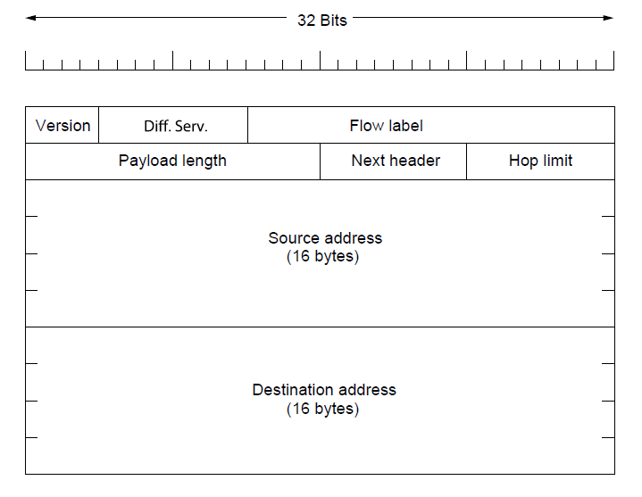
IP Version 6 (1)
The IPv6 fixed header (required).

Slide 41
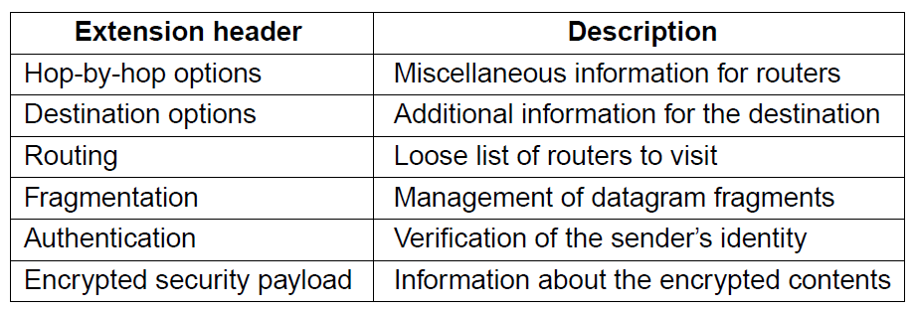
IP Version 6 (2)
IPv6 extension headers

Slide 42
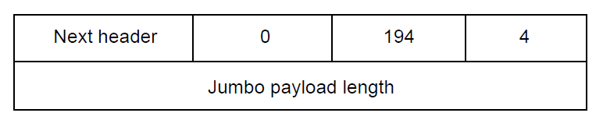
IP Version 6 (3)
The hop-by-hop extension header for
large datagrams (jumbograms).

Slide 43
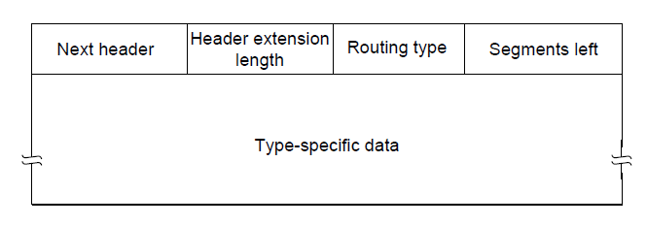
IP Version 6 (4)
The extension header for routing.

Slide 44
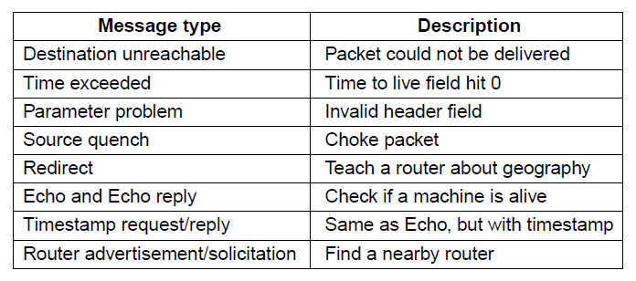
Internet Control Message Protocol
The principal ICMP message types.

Slide 45
Time exceeded path – when TTL becomes zero, the control packet comes back… Can be used for Traceroute
Congestion control – mainly done in transport layer
Redirect – router notices a packet is routed incorrectly
Echo – ping
Timestamp – arrival time and departure time
Router Advertisement – let hosts find nearby server

Slide 46
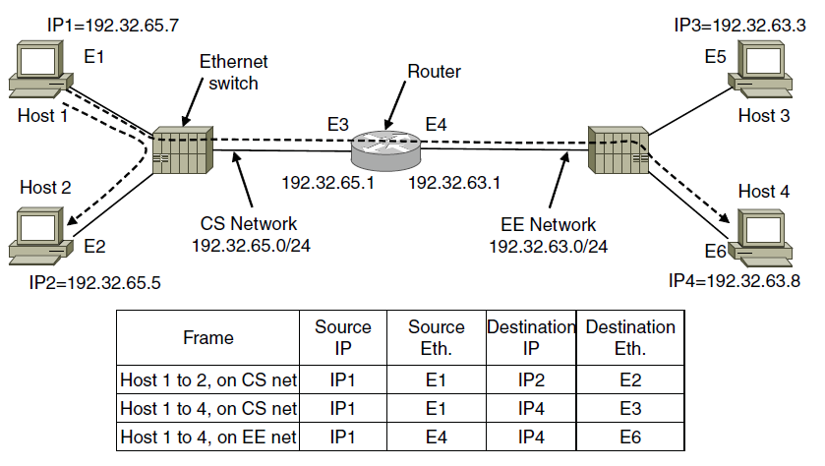
ARP– Address Resolution Protocol
Two switched Ethernet LANs joined by a router

Slide 47
Optimizations on ARP
Two Broad Techniques
Have configuration file
Broadcast
Optimizations for ARP:
Caching
Broadcast the mapping when booting (gratuitous ARP)
Send it to router if not local

Slide 48
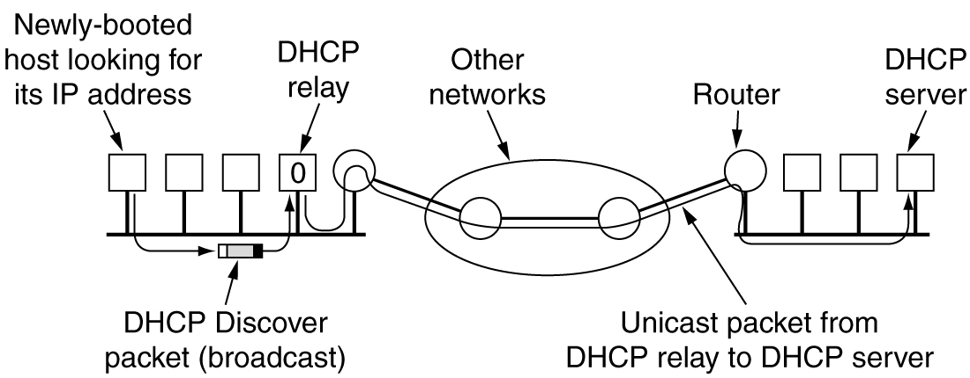
Dynamic Host Configuration Protocol
Operation of DHCP.
DHCP Relay, Broadcasts a DISCOVER,
Leasing of IP, if not renewed it is taken back.

Slide 49
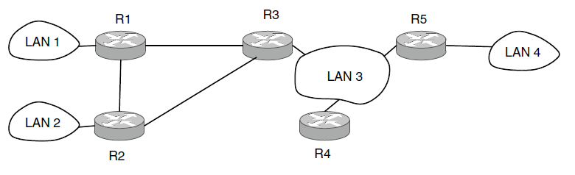
OSPF—An Interior Gateway
Routing Protocol (1)
An autonomous system

Slide 50
OSPF—An Interior Gateway
Routing Protocol (5)
Salient Features:
O – open source
Support variety of distant metrics
Dynamic algorithm – have to adapt
Load balancing and not the best path
Hierarchical systems
Security is needed
OSPF supports connection – point-to-point/multi-access with broadcast
Notes:
What is tunnelling

Slide 51
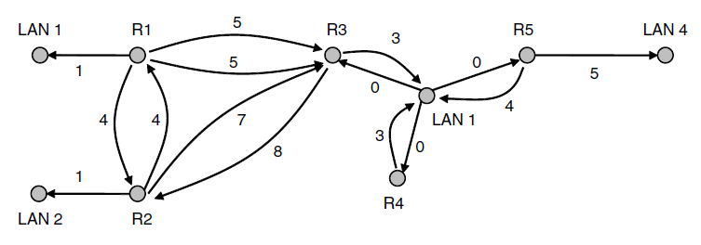
OSPF—An Interior Gateway
Routing Protocol (2)
A graph representation of the previous slide.

Slide 52
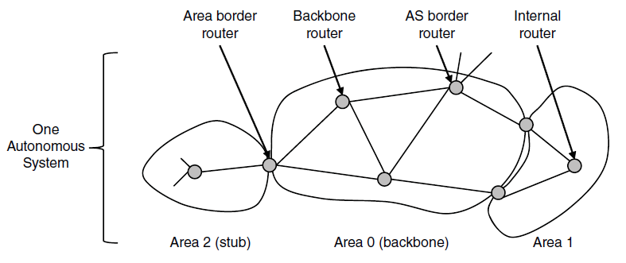
OSPF—An Interior Gateway
Routing Protocol (3)
The relation between ASes, backbones, and areas in OSPF.

Slide 53
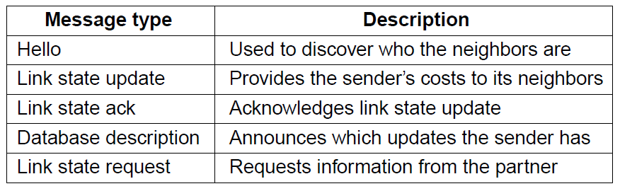
OSPF—An Interior Gateway
Routing Protocol (4)
The five types of OSPF messages

Slide 54
BGP—The Exterior Gateway
Routing Protocol (1)
Examples of routing constraints:
No commercial traffic for educat. network
Never put Iraq on route starting at Pentagon
Choose cheaper network
Choose better performing network
Don’t go from Apple to Google to Apple

Slide 55
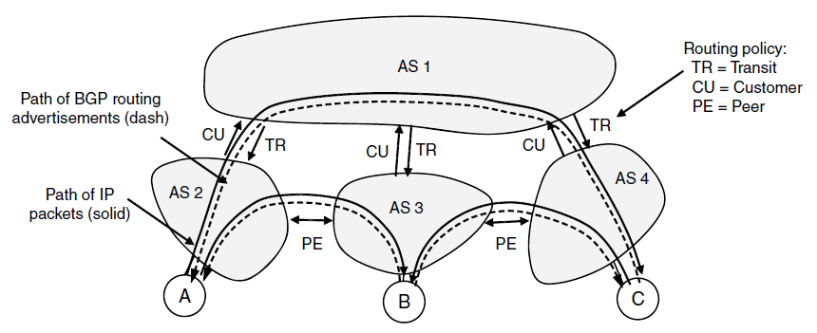
BGP—The Exterior Gateway
Routing Protocol (2)
Routing policies between four Autonomous Systems

Slide 56
Peering
Peering is not transitive
Early-exit or Hot Potato Routing
Exit own ISP fast

Slide 57
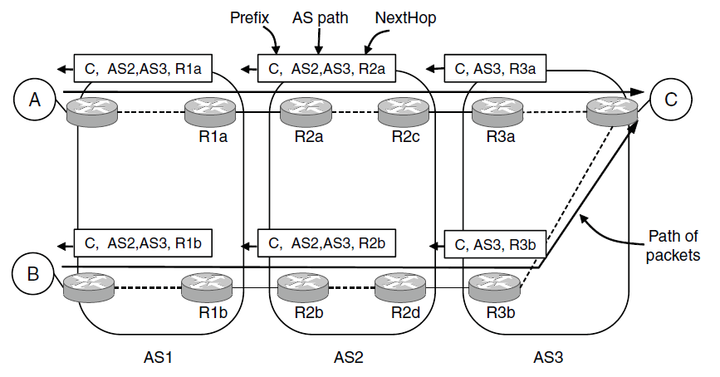
BGP—The Exterior Gateway
Routing Protocol (3)
Propagation of BGP route advertisements

Slide 58
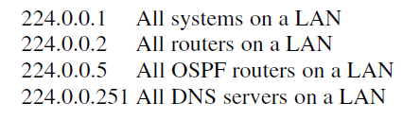
Internet Multicasting
Multicasting: Sender sends to a large number of receivers simultaneously.
Examples: streaming a live sports event to many viewers, delivering program updates to a pool of replicated servers.
In IP, each class D address identifies a group of hosts; 28 bits available for identifying groups.
  Fig: Examples of local multicast addresses

Slide 59
Mobile IP
Goals:
Mobile host use home IP address anywhere.
No software changes to fixed hosts
No changes to router software, tables
Packets for mobile hosts – restrict detours
No overhead for mobile host at home.

Slide 60
End
Chapter 5

Slide 61
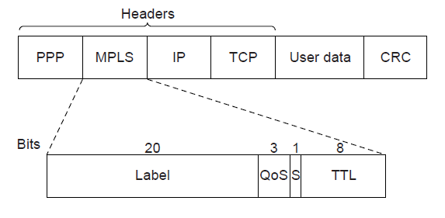
Label Switching and MPLS (1)
Transmitting a TCP segment using IP, MPLS, and PPP.

Slide 62
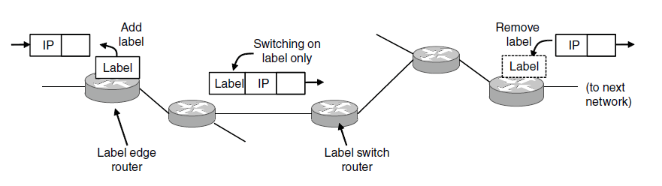
Label Switching and MPLS (2)
Forwarding an IP packet through an MPLS network

